Slide 1
Lecture 22: Ch 8
Punjab University College of Information Technology

Slide 2
Software Design
Requirements Model focuses on design required
Data, Function and behavior
Design creates a model of the software to provide detail about software architecture, data structures, interfaces and components that are necessary to implement the system

Slide 3
What is Architecture
For building, architecture mean overall shape of the physical structure - No
Architecture is the manner in which components of building are integrated
For S/W
Software consists of components
The externally visible properties of components
Relationship among them
At architecture no internal details/algo

Slide 4
What is Architecture
Design of Software architecture considers two levels of design
Data Design
Represents the data component of the architecture
Architectural Design
Focuses on the representation of the structure of software components their properties and interactions

Slide 5
Requirements to Design Model Translation
D
a
t
a
O
b
j
e
c
t
D
e
s
c
r
i
p
t
i
o
n
P
r
o
c
e
s
s
S
p
e
c
i
f
i
c
a
t
i
o
n
(
P
S
P
E
C
)
p
r
o
c
e
d
u
r
a
l
E
n
t
i
t
y
-
d
e
s
i
g
n
R
e
l
a
t
i
o
n
s
h
i
p
D
a
t
a
F
l
o
w
D
i
a
g
r
a
m
D
i
a
g
r
a
m
i
n
t
e
r
f
a
c
e
D
a
t
a
D
i
c
t
i
o
n
a
r
y
d
e
s
i
g
n
a
r
c
h
i
t
e
c
t
u
r
a
l
S
t
a
t
e
-
T
r
a
n
s
i
t
i
o
n
d
e
s
i
g
n
D
i
a
g
r
a
m
d
a
t
a
C
o
n
t
r
o
l
S
p
e
c
i
f
i
c
a
t
i
o
n
(
C
S
P
E
C
)
d
e
s
i
g
n
THE ANALYSIS MODEL
THE DESIGN MODEL

Slide 6
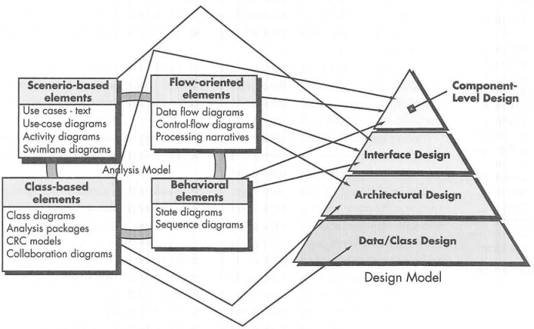
Requirements to Design Model Translation

Slide 7
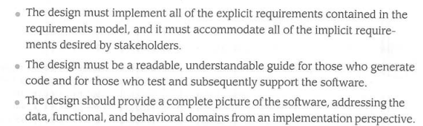
The Design Process
Through out the design process, the quality of the design is assessed

Slide 8
Design Principles
The design process should not suffer from ‘tunnel vision.’
The design should be traceable to the analysis model.
The design should not reinvent the wheel.
The design should “minimize the intellectual distance” [DAV95] between the software and the problem as it exists in the real world.
The design should exhibit uniformity and integration.
From Davis [DAV95]

Slide 9
Design Principles
The design should be structured to accommodate change.
Design is not coding, coding is not design.
The design should be assessed for quality as it is being created, not after that.
The design should be reviewed to minimize conceptual (semantic) errors.
Syntax vs semantic
From Davis [DAV95]

Slide 10
Quality Attributes
FURPS – functionality, usability, reliability, performance and supportability
Functionality – assessed by evaluating features set, program capabilities, & security
Usability – is assessed by considering human factors, consistency & documentation
Reliability – by measuring frequency and severity of failure, accuracy of output results, ability to recover from failure and predictability

Slide 11
Quality Attributes
Performance – measured by considering processing speed, response time, resource consumption, throughput and efficiency
Supportability – testability, compatibility, maintainability (combination of extensibility, serviceability), ease of installation

Slide 12
Fundamental Concepts
abstraction—data, procedure, control
refinement—elaboration of detail for all abstractions
modularity—compartmentalization of data and function
architecture—overall structure of the software
Structural properties
Extra-structural properties
Styles and patterns
Control hierarchy — program structure
hiding—controlled interfaces

Slide 13
1. Abstraction
At highest level of abstraction, solution is presented in broad terms
A lowest level of abstraction, the solution is stated in a manner that can be directly implemented
Lowest level of abstraction is reached when source code is generated
Procedural abstraction
Data abstraction

Slide 14
Data Abstraction
door
manufacturer
model number
type
swing direction
inserts
lights
type
number
weight
opening mechanism
implemented as a data structure

Slide 15
Procedural Abstraction
open
details of enter
algorithm
implemented with a "knowledge" of the
object that is associated with enter

Slide 16
2. Refinement
Stepwise refinement is a top-down strategy
Program is developed by successively refining levels of procedural detail – hierarchy is developed
Refinement is actually a process of elaboration
Abstraction and refinement are complementary concepts

Slide 17
Stepwise Refinement
open
walk to door;
reach for knob;
open door;
repeat until door opens
turn knob clockwise;
walk through;
if knob doesn't turn, then
close door.
take key out;
find correct key;
insert in lock;
endif
pull/push door
move out of way;
end repeat

Slide 18
3. Modularity
Software is divided into separately named and addressable components often called modules
Divide and conquers
More modules means smaller individual size

Slide 19
Modular Design

Slide 20
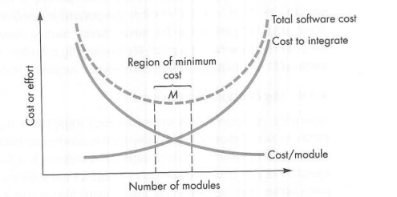
Modules Integration Curve
However, as number of modules grows, the cost of integrating modules also grows

Slide 21
Modularity: Trade-offs
What is the "right" number of modules
for a specific software design?
module development cost
cost of
software
module
integration
cost
optimal number
number of modules
of modules

Slide 22
4. Architecture
“The overall structure of the software and the ways in which that structure provides conceptual integrity for a system.” [SHA95a]
Structural properties. This aspect of the architectural design representation defines the components of a system (e.g., modules, objects, filters) and the manner in which those components are packaged and interact with one another. For example, objects are packaged to encapsulate both data and the processing that manipulates the data and interact via the invocation of methods .
Extra-functional properties. The architectural design description should address how the design architecture achieves requirements for performance, capacity, reliability, security, adaptability, and other system characteristics.

Slide 23
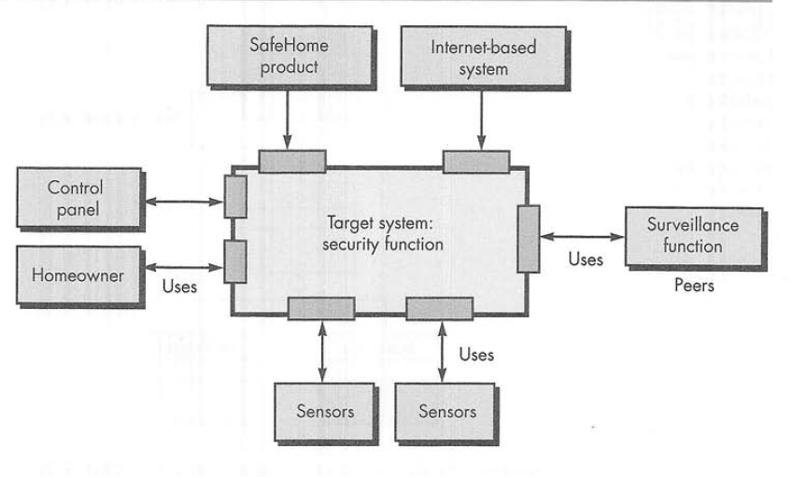
4. Architecture
“The overall structure of the software and the ways in which that structure provides conceptual integrity for a system.” [SHA95a]

Slide 24
5. Control Hierarchy
Program Structure, represents the organization of program components(modules) and implies a hierarchy of control.
NO concern to procedural aspects of software

Slide 25
EXECUTIVE
Fan out
MODULE A
MODULE B
MODULE C
MODULE D
MODULE E
MODULE F
MODULE G
Depth
Module X
Module Y
Module Q
Module R
Module M
Module N
Fan in
Module K
Module L
Module S
Breadth

Slide 26
Major Concepts
Depth = 3
Width = 7
Fan-out (the numbers of modules that are called by a given module)
fan-out (module B)=2
Fan-in ( the number of modules that call a given module):
fan-in (module S)=2
Super ordinate (module M is super ordinate of module S)
Subordinate (module S is subordinate of module M)

Slide 27
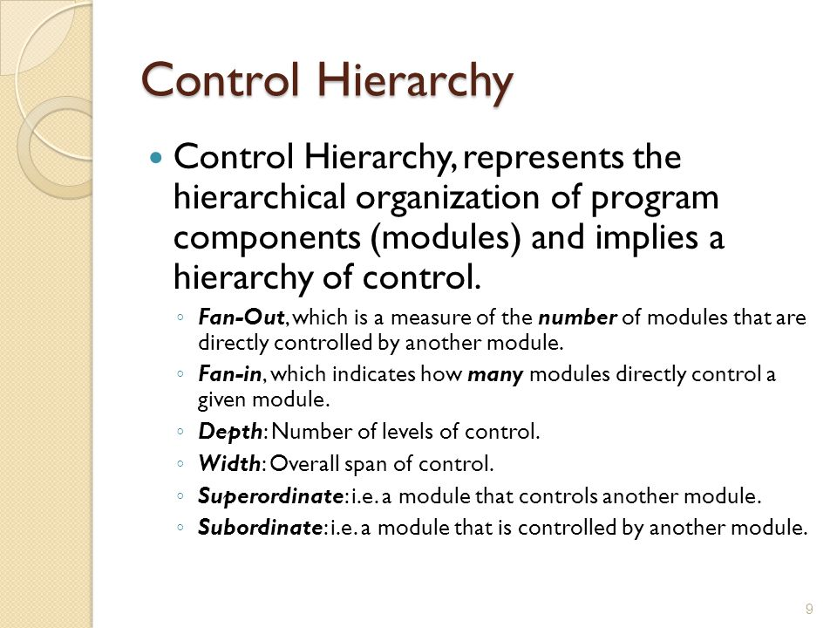
Major Concepts

Slide 28
6. Information Hiding
module
• algorithm
controlled
interface
• data structure
• details of external interface
• resource allocation policy
clients
"secret"
a specific design decision

Slide 29
Why Information Hiding?
reduces the likelihood of “side effects”
limits the global impact of local design decisions
emphasizes communication through controlled interfaces
discourages the use of global data
results in higher quality software

Slide 30
Effective Modular Design
Modular design reduces complexity
Facilitate change (critical in s/w maintainability)
Results in easier implementation (//ism)

Slide 31
Functional Independence

Slide 32
Cohesion
A natural extension to information hiding
A cohesive module should (ideally) do just one thing
High cohesion should be achieved and low cohesion should be avoided
LEVELS of COHESION

Slide 33
Coupling
A measure of interconnection among modules in a software structure
Coupling depends on:
Interface Complexity between modules
Entry Point
Data that is passed across the interface
We strive for low coupling ideally

Slide 34
Architectural Design

Slide 35
What is Architecture
For building, architecture mean overall shape of the physical structure - No
Architecture is the manner in which components of building are integrated
For S/W
Software consists of components
The externally visible properties of components
Relationship among them
At architecture no internal details/algo

Slide 36
What is Architecture
Design of Software architecture considers two levels of design
Data Design
Represents the data component of the architecture
Architectural Design
Focuses on the representation of the structure of software components their properties and interactions

